Slide 1

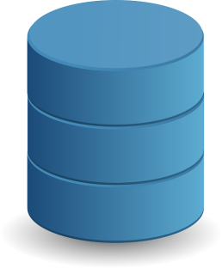
Serialization in Java
Serialization is the process of converting an object's state (including its references) to a sequence of bytes, as well as the process of rebuilding those bytes into a live object at some future time. Simple......Converting an object to bytes and bytes back to object.
Object
DB
Stream Of bytes
Memory

Slide 2
Serialization in Java
Uses for Serialization
Serialization is used when you want to persist the object.
Serialization is also used by RMI to pass objects between JVMs, either as arguments in a method invocation from a client to a server or as return values from a method invocation. In general, serialization is used when we want the object to exist beyond the lifetime of the JVM.
To persist data for future use.
To send data to a remote computer using such client/server Java technologies as RMI or socket programming.
To "flatten" an object into array of bytes in memory.
To exchange data between applets and servlets.
To store user session in Web applications.
To activate/passivate enterprise java beans.
To send objects between the servers in a cluster.

